Slide 1
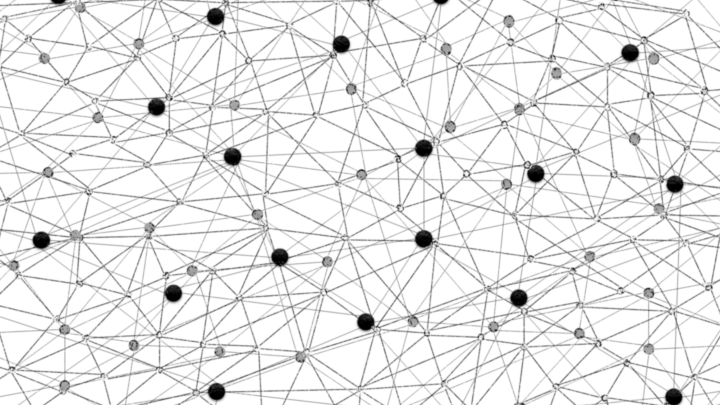
Using Text Embeddings for Information Retrieval
Bhaskar Mitra, Microsoft (Bing Sciences) http://research.microsoft.com/people/bmitra

Slide 2
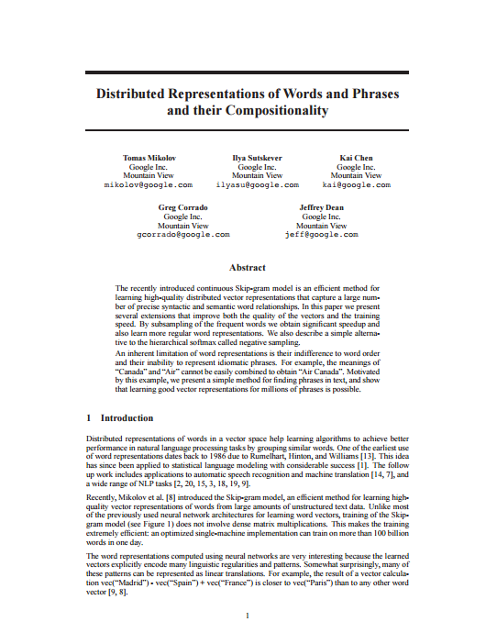
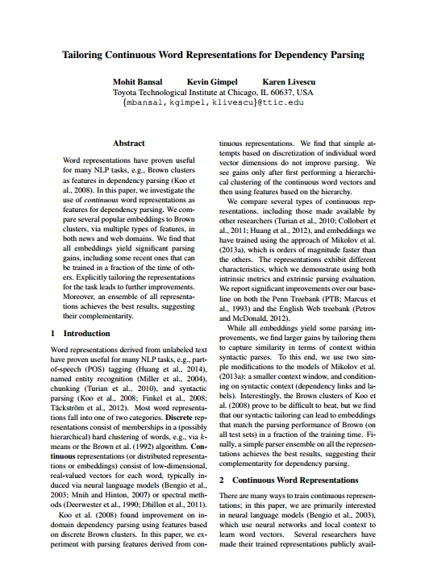
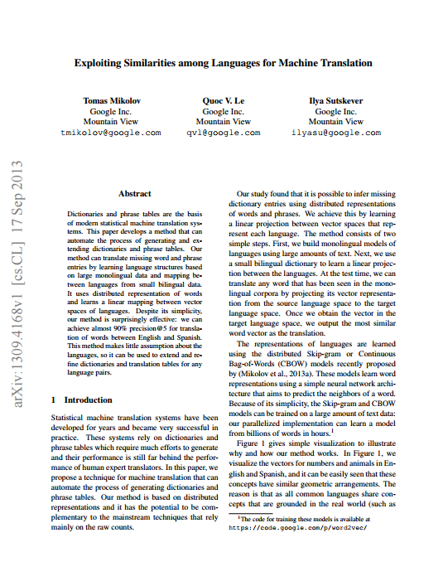
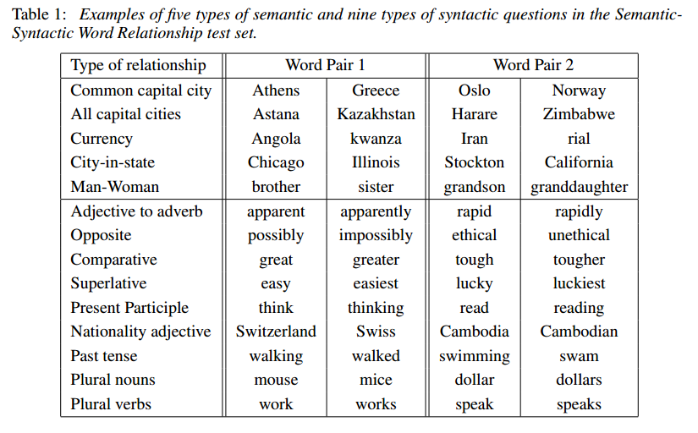
Neural text embeddings are responsible for many recent performance improvements in Natural Language Processing tasks
Mikolov et al. "Distributed representations of words and phrases and their compositionality." NIPS (2013).
Mikolov et al. "Efficient estimation of word representations in vector space." arXiv preprint (2013).
Bansal, Gimpel, and Livescu. "Tailoring Continuous Word Representations for Dependency Parsing." ACL (2014).
Mikolov, Le, and Sutskever. "Exploiting similarities among languages for machine translation." arXiv preprint (2013).

Slide 3
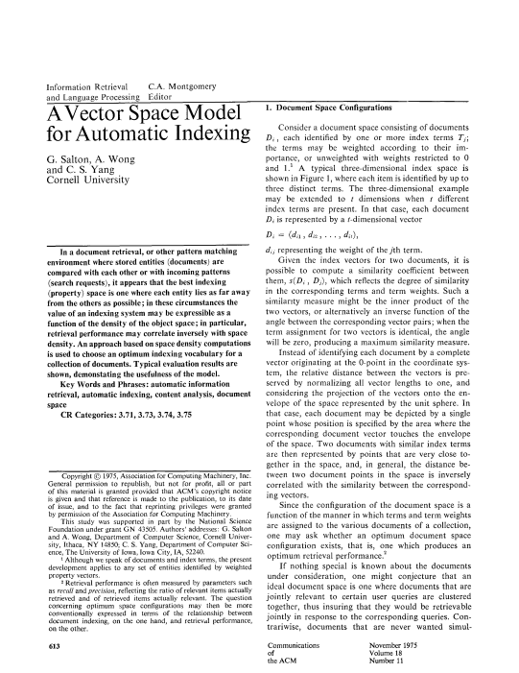
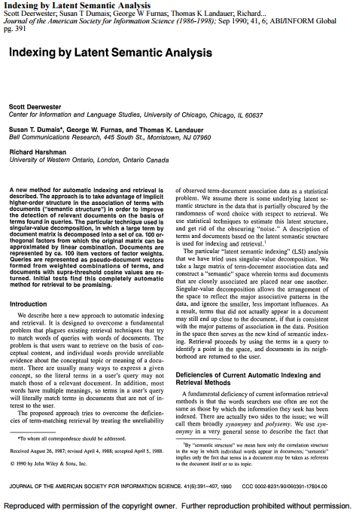
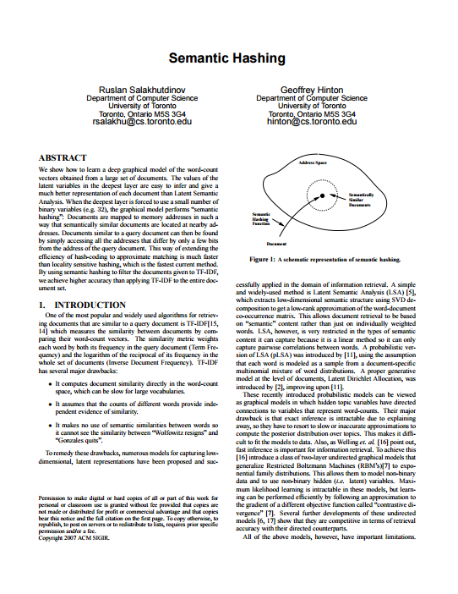
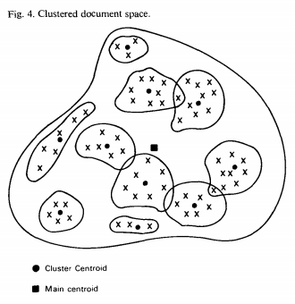
There is also a long history of vector space models (both dense and sparse) in information retrieval
Salton, Wong, and Yang. "A vector space model for automatic indexing." ACM (1975).
Deerwester et al. "Indexing by latent semantic analysis." JASIS (1990).
Salakhutdinov, and Hinton. "Semantic hashing.“ SIGIR (2007).

Slide 4
What is an embedding?
A vector representation of items
Vectors are real-valued and dense
Vectors are small
Number of dimensions much smaller than the number of items
Items can be…
Words, short text, long text, images, entities, audio, etc. – depends on the task

Slide 5
Think sparse, act dense
Mostly the same principles apply to both the vector space models
Sparse vectors are easier to visualize and reason about
Learning embeddings is mostly about compression and generalization over their sparse counterparts

Slide 6
Learning word embeddings
Start with a paired items dataset
[source, target]
Source
Item
Target
Item
Source Embedding
Target
Embedding
Train a neural network
Bottleneck layer gives you a dense vector representation
E.g., word2vec
Distance
Metric
Pennington, Socher, and Manning. "Glove: Global Vectors for Word Representation." EMNLP (2014).

Slide 7
Learning word embeddings
Start with a paired items dataset
[source, target]
 | T0 | T1 | T2 | T3 | T4 | T5 | T6 | T7 | T8
S0
S1
S2
S3
S5
S6
S7
Make a Source x Target matrix
Factorizing the matrix gives you a dense vector representation
E.g., LSA, GloVe
Pennington, Socher, and Manning. "Glove: Global Vectors for Word Representation." EMNLP (2014).

Slide 8
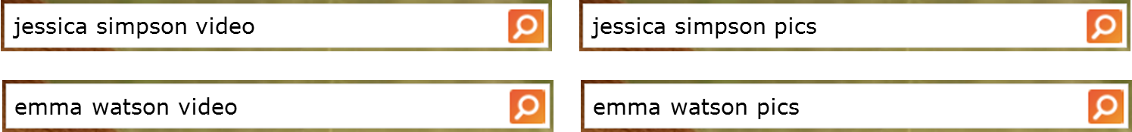
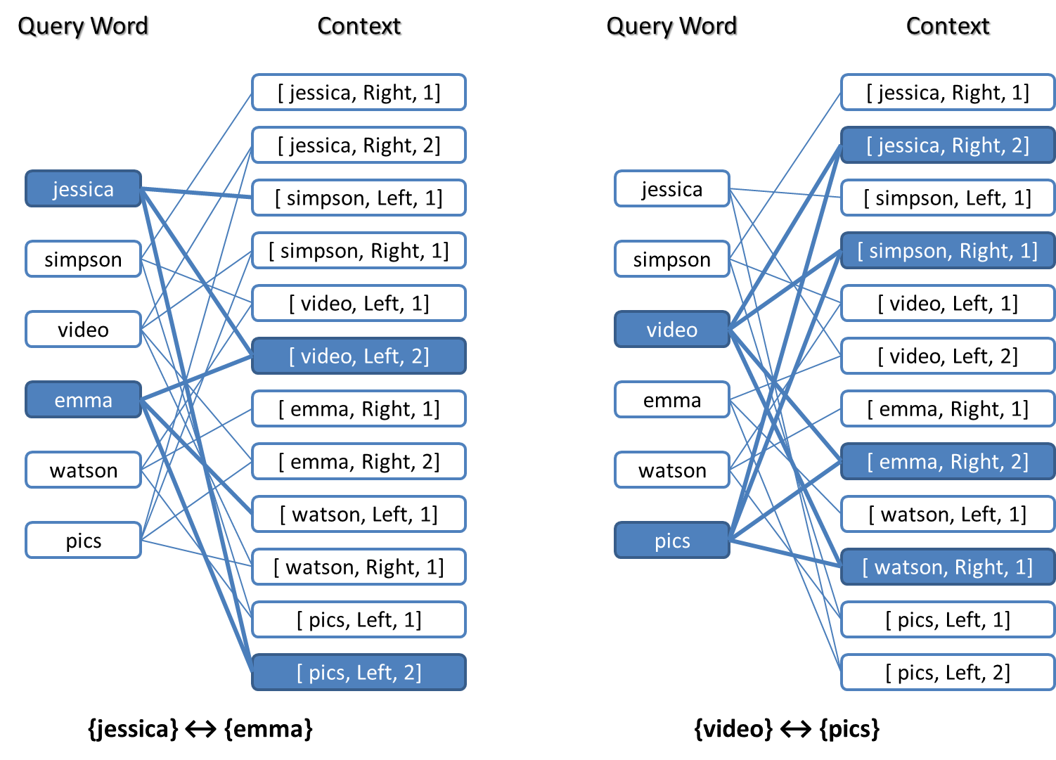
Learning word embeddings
Start with a paired items dataset
[source, target]
Make a bi-partite graph
PPMI over edges gives you a sparse vector representation
E.g., explicit representations
Levy et. al. “Linguistic regularities in sparse and explicit word representations”. CoNLL (2015)

Slide 9
Some examples of text embeddings
 | Embedding for | Source Item | Target Item | Learning Model
Latent Semantic Analysis Deerwester et. al. (1990) | Single word | Word (one-hot) | Document (one-hot) | Matrix factorization
Word2vec Mikolov et. al. (2013) | Single Word | Word (one-hot) | Neighboring Word (one-hot) | Neural Network (Shallow)
Glove Pennington et. al. (2014) | Single Word | Word (one-hot) | Neighboring Word (one-hot) | Matrix factorization
Semantic Hashing (auto-encoder) Salakhutdinov and Hinton (2007) | Multi-word text | Document (bag-of-words) | Same as source (bag-of-words) | Neural Network (Deep)
DSSM Huang et. al. (2013), Shen et. al. (2014) | Multi-word text | Query text (bag-of-trigrams) | Document title (bag-of-trigrams) | Neural Network (Deep)
Session DSSM Mitra (2015) | Multi-word text | Query text (bag-of-trigrams) | Next query in session (bag-of-trigrams) | Neural Network (Deep)
Language Model DSSM Mitra and Craswell (2015) | Multi-word text | Query prefix (bag-of-trigrams) | Query suffix (bag-of-trigrams) | Neural Network (Deep)

Slide 10
What notion of relatedness between words does your vector space model?
banana

Slide 11
What notion of relatedness between words does your vector space model?
banana
Doc2
Doc4
Doc7
Doc9
Doc11
The vector can correspond to documents in which the word occurs

Slide 12
What notion of relatedness between words does your vector space model?
banana
(yellow, -1)
(on, +2)
(grows, +1)
(tree, +3)
(africa, +5)
The vector can correspond to neighboring word context
e.g., “yellow banana grows on trees in africa”
-1
0
+1
+2
+3
+4
+5

Slide 13
What notion of relatedness between words does your vector space model?
banana
#ba
na#
ana
nan
ban
The vector can correspond to character trigrams in the word

Slide 14
Each of the previous vector spaces model a different notion of relatedness between words

Slide 15
Let’s consider the following example…
We have four (tiny) documents,
Document 1 : “seattle seahawks jerseys”
Document 2 : “seattle seahawks highlights”
Document 3 : “denver broncos jerseys”
Document 4 : “denver broncos highlights”

Slide 16
If we use document occurrence vectors…
Document 1
Document 3
Document 2
Document 4
seattle
similar
seahawks
denver
similar
broncos
In the rest of this talk, we refer to this notion of relatedness as Topical similarity.

Slide 17
If we use word context vectors…
(seattle, -1)
(denver, -1)
(jerseys, + 1)
(highlights, +1)
(seahawks, +1)
(broncos, +1)
(jerseys, + 2)
(highlights, +2)
seattle
seahawks
similar
denver
similar
broncos
In the rest of this talk, we refer to this notion of relatedness as Typical (by-type) similarity.

Slide 18
If we use character trigram vectors…
#se
set
ett
ttl
le#
sea
eat
att
tle
seattle
similar
settle
This notion of relatedness is similar to string edit-distance.

Slide 19
What does word2vec do?
Uses word context vectors but without the inter-word distance
For example, let’s consider the following “documents”
“seahawks jerseys”
“seahawks highlights”
“seattle seahawks wilson”
“seattle seahawks sherman”
“seattle seahawks browner”
“seattle seahawks lfedi”
“broncos jerseys”
“broncos highlights”
“denver broncos lynch”
“denver broncos sanchez”
“denver broncos miller”
“denver broncos marshall”

Slide 20
What does word2vec do?
seattle
denver
jerseys
wilson
browner
lynch
miller
seahawks
broncos
highlights
sherman
lfedi
sanchez
marshall
seattle
seahawks
denver
broncos
similar
[seahawks] – [seattle] + [Denver]
Mikolov et al. "Distributed representations of words and phrases and their compositionality." NIPS (2013).
Mikolov et al. "Efficient estimation of word representations in vector space." arXiv preprint (2013).

Slide 21
Session Modelling
Use Case #1
Text Embeddings for

Slide 22
How do you model that the intent shift
is similar to
london
things to do in london
new york
new york tourist attractions

Slide 23
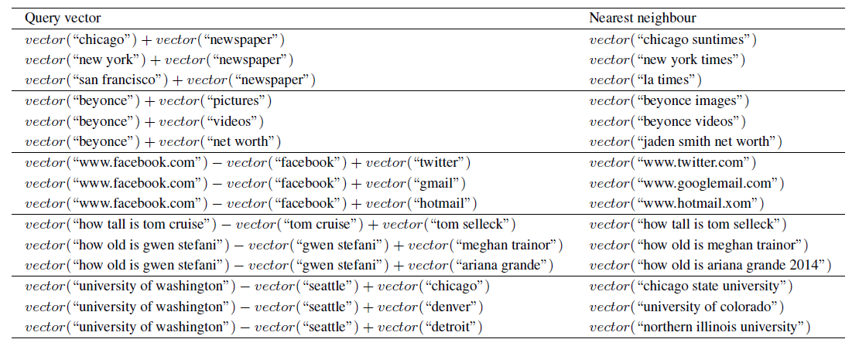
We can use vector algebra over queries!
Mitra. " Exploring Session Context using Distributed Representations of Queries and Reformulations." SIGIR (2015).

Slide 24
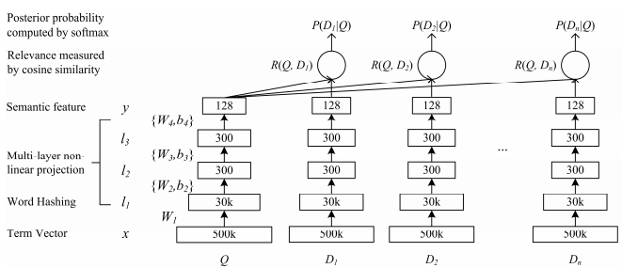
A brief introduction to DSSM
DNN trained on clickthrough data to maximize cosine similarity
Tri-gram hashing of terms for input
P.-S. Huang, et al. “Learning deep structured semantic models for web search using clickthrough data.” CIKM (2013).

Slide 25
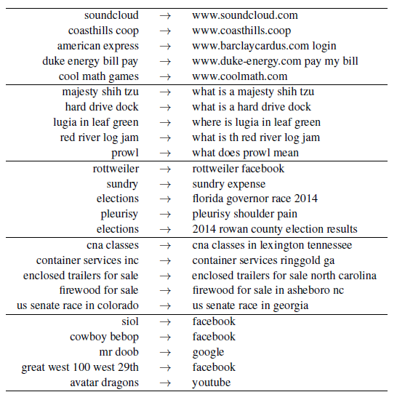
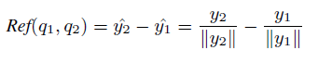
Learning query reformulation embeddings
Train a DSSM over session query pairs
The embedding for q₁→q₂ is given by,
Mitra. " Exploring Session Context using Distributed Representations of Queries and Reformulations." SIGIR (2015).

Slide 26
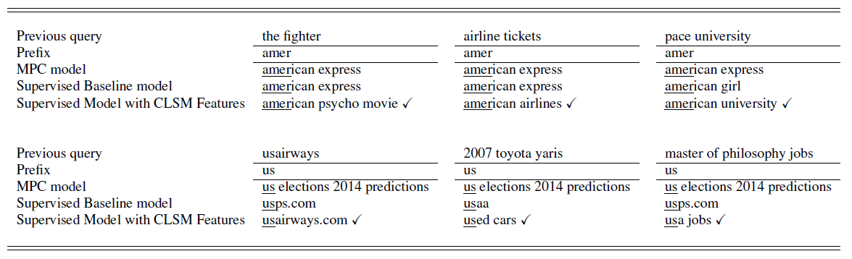
Using reformulation embeddings for contextualizing query auto-completion
Mitra. " Exploring Session Context using Distributed Representations of Queries and Reformulations." SIGIR (2015).

Slide 27
Ideas I would love to discuss!
Future Work
Modelling search trails as paths in the embedding space
Using embeddings to discover latent structure in information seeking tasks
Embeddings for temporal modelling

Slide 28
Document Ranking
Use Case #2
Text Embeddings for

Slide 29
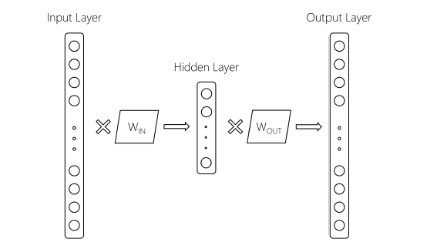
What if I told you that everyone who uses Word2vec is throwing half the model away?
Word2vec optimizes IN-OUT dot product which captures the co-occurrence statistics of words from the training corpus
Mitra, et al. "A Dual Embedding Space Model for Document Ranking." arXiv preprint (2016).
Nalisnick, et al. "Improving Document Ranking with Dual Word Embeddings." WWW (2016).

Slide 30
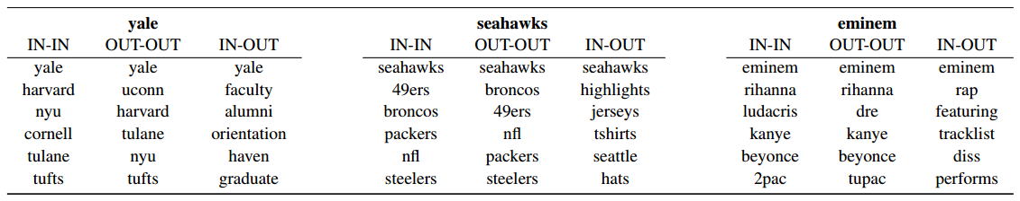
Different notions of relatedness from IN-IN and IN-OUT vector comparisons using word2vec trained on Web queries
Mitra, et al. "A Dual Embedding Space Model for Document Ranking." arXiv preprint (2016).
Nalisnick, et al. "Improving Document Ranking with Dual Word Embeddings." WWW (2016).

Slide 31
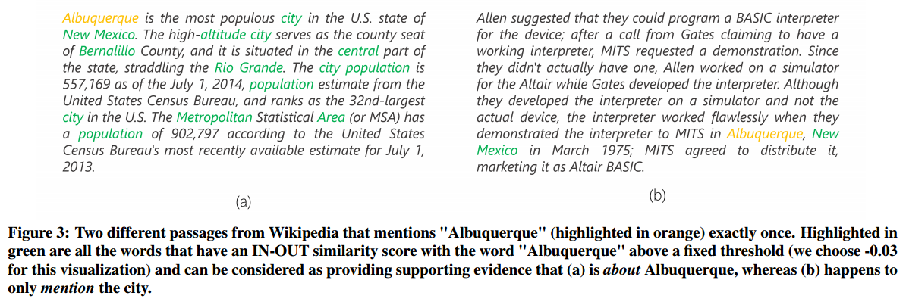
Using IN-OUT similarity to model document aboutness
Mitra, et al. "A Dual Embedding Space Model for Document Ranking." arXiv preprint (2016).
Nalisnick, et al. "Improving Document Ranking with Dual Word Embeddings." WWW (2016).

Slide 32
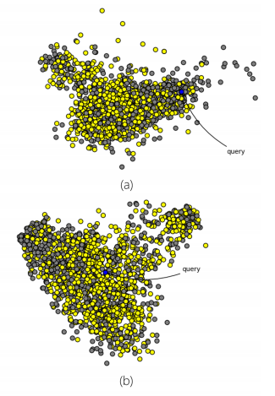
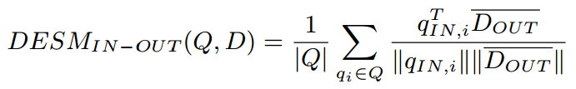
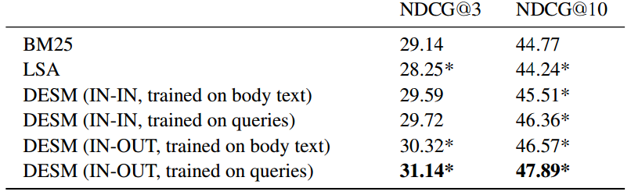
Dual Embedding Space Model (DESM)
Map query words to IN space and document words to OUT space and compute average of all-pairs cosine similarity
Mitra, et al. "A Dual Embedding Space Model for Document Ranking." arXiv preprint (2016).
Nalisnick, et al. "Improving Document Ranking with Dual Word Embeddings." WWW (2016).

Slide 33
Ideas I would love to discuss!
Future Work
Exploring traditional IR concepts (e.g., term frequency, term importance, document length normalization, etc.) in the context of dense vector representations of words
How can we formalize what relationship (typical, topical, etc.) an embedding space models?

Slide 34
Get the data
Download
IN+OUT Embeddings for 2.7M words
trained on 600M+ Bing queries
research.microsoft.com/projects/DESM

Slide 35
Query Auto-Completion
Use Case #3
Text Embeddings for

Slide 36
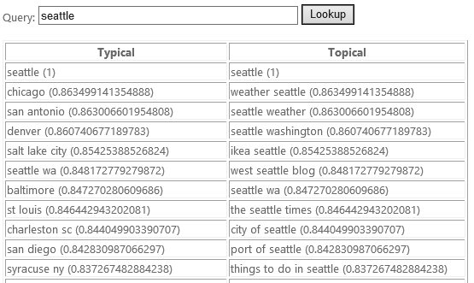
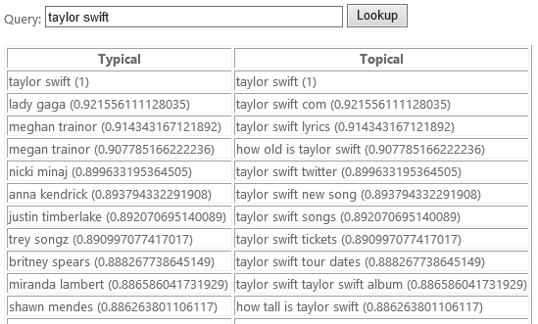
Typical and Topical similarities for text (not just words!)
Mitra and Craswell. "Query Auto-Completion for Rare Prefixes." CIKM (2015).

Slide 37
The Typical-DSSM is trained on query prefix-suffix pairs, as opposed to the Topical-DSSM trained on query-document pairs
We can use the Typical-DSSM model for query auto-completion for rare or unseen prefixes!
Mitra and Craswell. "Query Auto-Completion for Rare Prefixes." CIKM (2015).

Slide 38
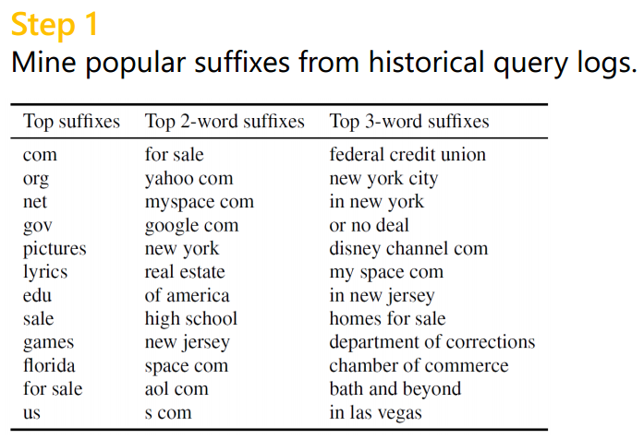
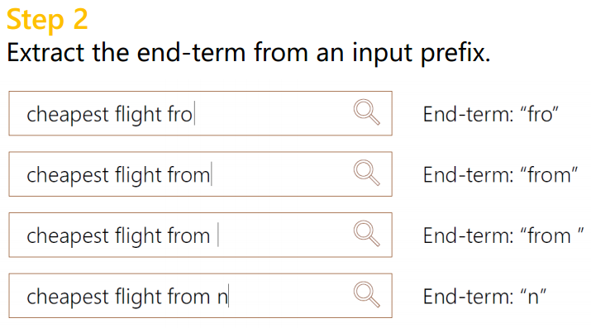
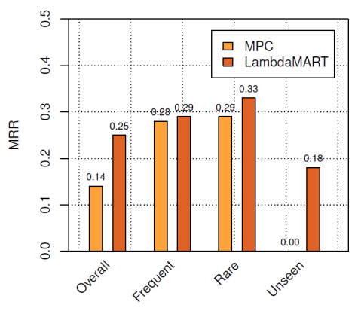
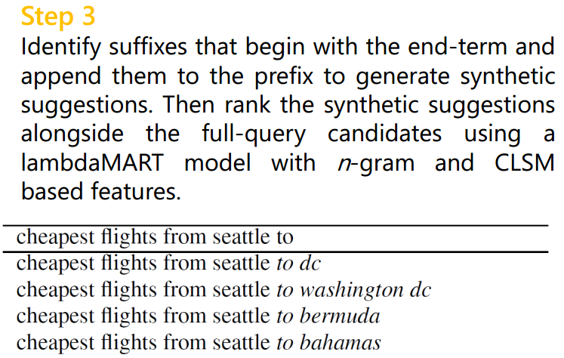
Query auto-completion for rare prefixes
Mitra and Craswell. "Query Auto-Completion for Rare Prefixes." CIKM (2015).

Slide 39
Ideas I would love to discuss!
Future Work
Query auto-completion beyond just ranking “previously seen” queries
Neural models for query completion (LSTMs/RNNs still perform surprisingly poorly on metrics like MRR)

Slide 40




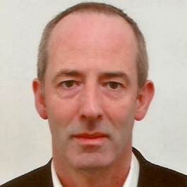

Neu-IR 2016
(Call for Participation)
Thank You!
The SIGIR 2016 Workshop on Neural Information Retrieval
Pisa, Tuscany, Italy
Workshop: July 21st, 2016
Submission deadline: May 30th, 2016
http://research.microsoft.com/neuir2016
Organizers
Nick Craswell
Bing, Microsoft
Bellevue, US
Bhaskar Mitra
Bing, Microsoft
Cambridge, UK
W. Bruce Croft
University of Massachusetts
Amherst, US
Maarten de Rijke
University of Amsterdam
Amsterdam, The Netherlands
Jiafeng Guo
Chinese Academy of Sciences
Beijing, China

